Slide 1


Predicting The Energy Output of Wind Turbine Based By Using Machine Learning
Represented By:
Shouvik khan, Sayantan das, Mirjul hoque, Parthajit ranA, Pankaj kumar, Sattrajit saha, Somnath das
Under the guidance of
prof. ANIRBAN BOSE
Department of Mechanical Engineering
Meghnad Saha Institute of Technology, Kolkata

Slide 2
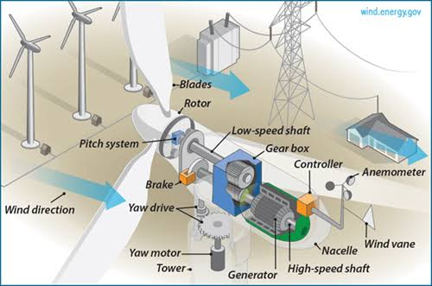
INTRODUCTION
Wind energy plays a major role in providing energy worldwide. Renewable energies are set to conquer the global energy system faster than any other fuel in history. A wind farm's energy output depends heavily on the weather conditions present at its site. A wind performance forecast is an estimation of the production expected of one or more wind turbines.If the output can indeed be predicted more effectively, the energy providers can more effectively organize the joint development of various energy sources to avoid expensive overproduction.

Slide 3
Objective of project
This project facilitates:
Identifying most significant features for wind power prediction.
Continuous learning and model improvement by hybrid ensemble with data and
function perturbation.
Predicting best time for wind farm energy utilization.
Integrating weather conditions for predicting various time periods like per day, per
week, per month, and annual reports for wind energy generation.
Graphical representations and reports to support various business decisions on
improving wind energy generation.
Balancing production and utilization of the wind energy.

Slide 4
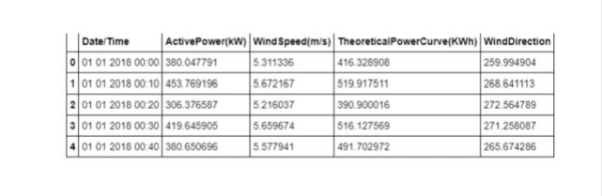
Dataset
Dataset: https://www.kaggle.com/jaisandeshls/final-year-simulation-project

Slide 5
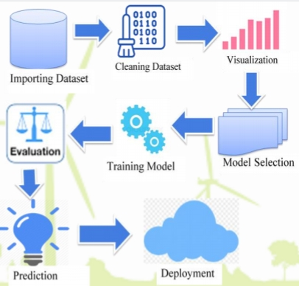
Model creation
FLOWCHART: Project modules and working
Shows the flow of project modules implementation.
Represents generalized project steps carried and their synchronization.

Slide 6
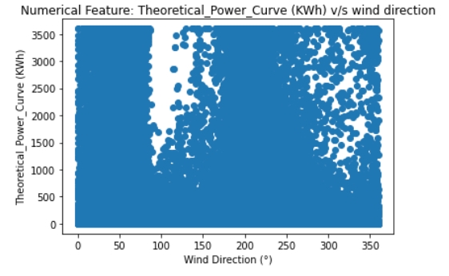
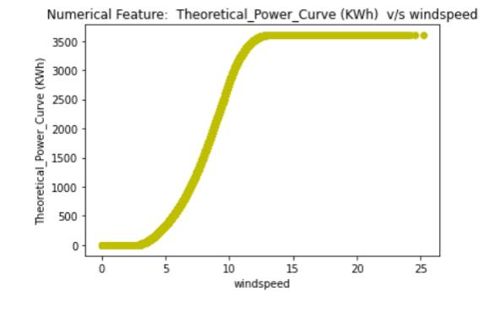
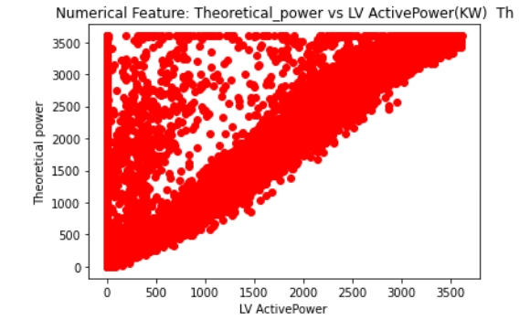
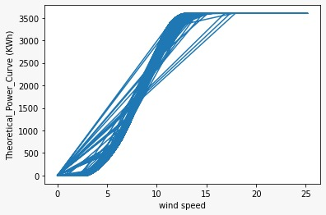
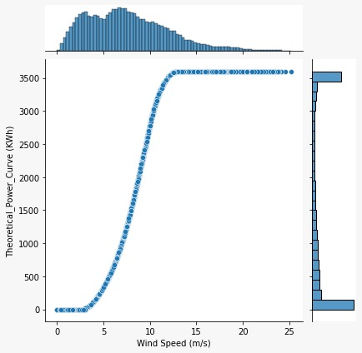
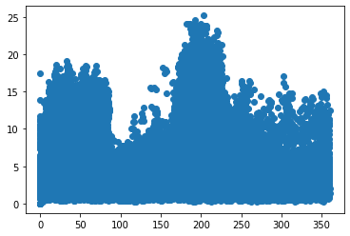
data visualization

Slide 7
comparsion
Model | Accuracy
Random forest regression | 0.9390 or 93.90%
Decision tree regression | 0.9077 or 90.77 %
logistic regression | 0.8303 or 83.03%
XGB Regression | 0.9277 or 92.77%

Slide 8
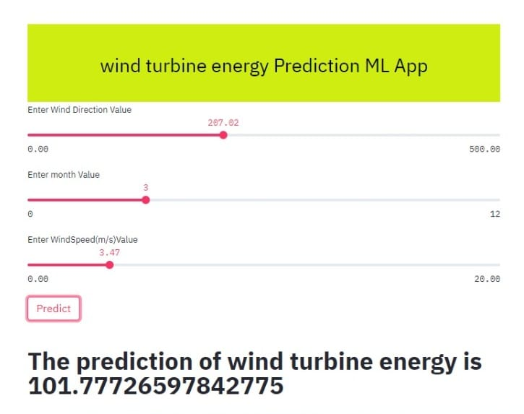
Model/app

Slide 9
CONCLUSION
As seen from results and discussion, the proposed algorithms give satisfying results for ten-minute measurements.
For short term prediction, large number of training data is not required.

Slide 10
future scope
Some of the future research tasks can be targeted as:
To identify more environment parameters for testing their impact on wind energy generation.
To avail on-demand supply of wind energy.
To predict customer usage pattern and try to map with the wind energy generation for better business production.

